Slide 1
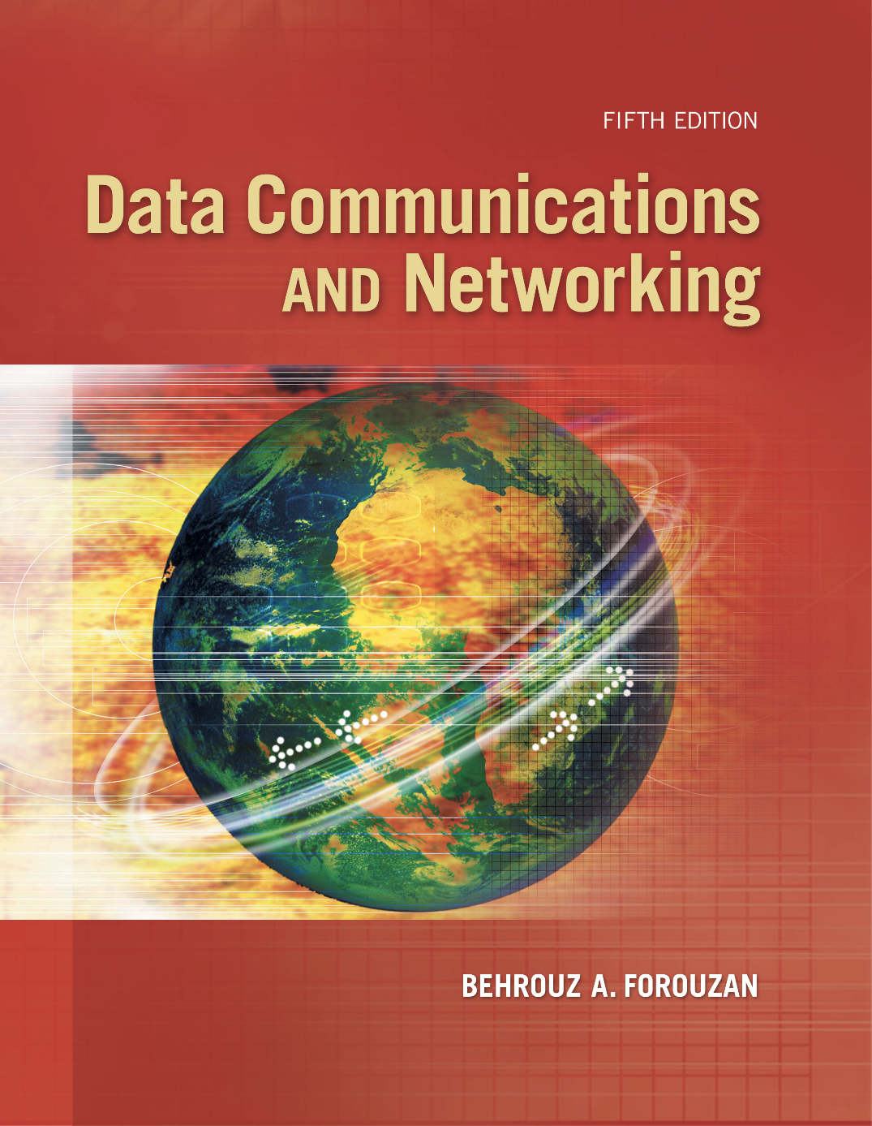
Chapter 6
Bandwidth Utilization
Copyright © The McGraw-Hill Companies, Inc. Permission required for reproduction or display.
Notes:
‹#›

Slide 2
Chapter 6: Outline
6.1 MULTIPLEXING
6.2 SPREAD SPECTRUM
Notes:
6.#

Slide 3

Chapter 6: Objective
The first section discusses multiplexing. The first method is called frequency-division multiplexing (FDM). The second method is called wavelength division multiplexing (WDM). The third method is called time-division multiplexing (TDM).
The second section discusses spectrum spreading, in which we first spread the bandwidth of a signal to add redundancy for the purpose of more secure transmission before combining different channels. The first method is called frequency hopping spread spectrum (FHSS). The second method is called direct sequence spread spectrum (DSSS).
Notes:
6.#

Slide 4
6-1 MULTIPLEXING
Multiplexing is the set of techniques that allows the simultaneous transmission of multiple signals across a single data link. As data and telecommunications use increases, so does traffic. We can accommodate this increase by continuing to add individual links each time a new channel is needed, or we can install higher-bandwidth links and use each to carry multiple signals.
6.‹#›
Notes:
6.#

Slide 5
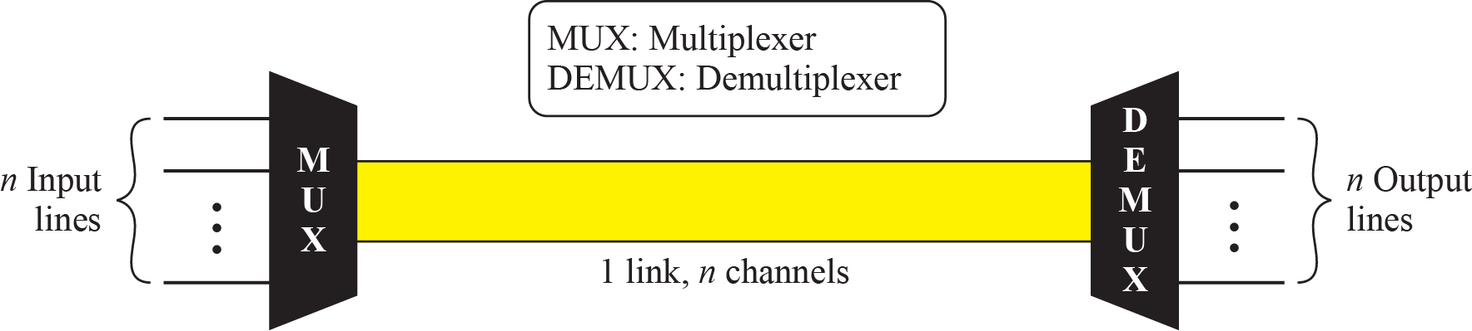
Figure 6.1: Dividing a link into channels
6.‹#›
Notes:
6.#

Slide 6
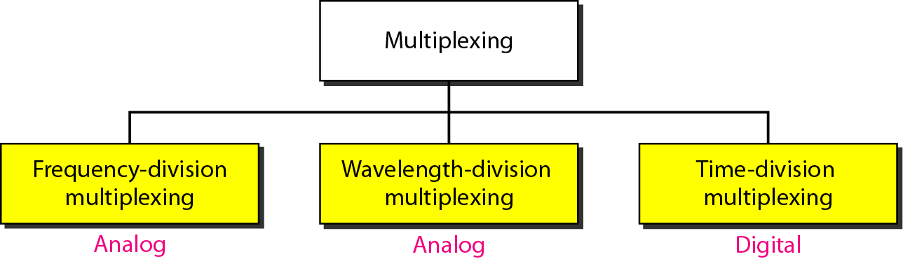
Figure 6.2: Categories of multiplexing
6.‹#›
Notes:
6.#

Slide 7
6.6.1 Frequency-Division Multiplexing
Frequency-division multiplexing (FDM) is an analog technique that can be applied when the bandwidth of a link (in hertz) is greater than the combined bandwidths of the signals to be transmitted. In FDM, signals generated by each sending device modulate different carrier frequencies. These modulated signals are then combined into a single composite signal that can be transported by the link.
6.‹#›
Notes:
6.#

Slide 8
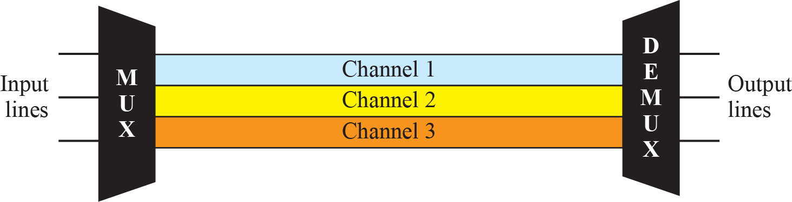
Figure 6.3: Frequency-division multiplexing
6.‹#›
Notes:
6.#

Slide 9
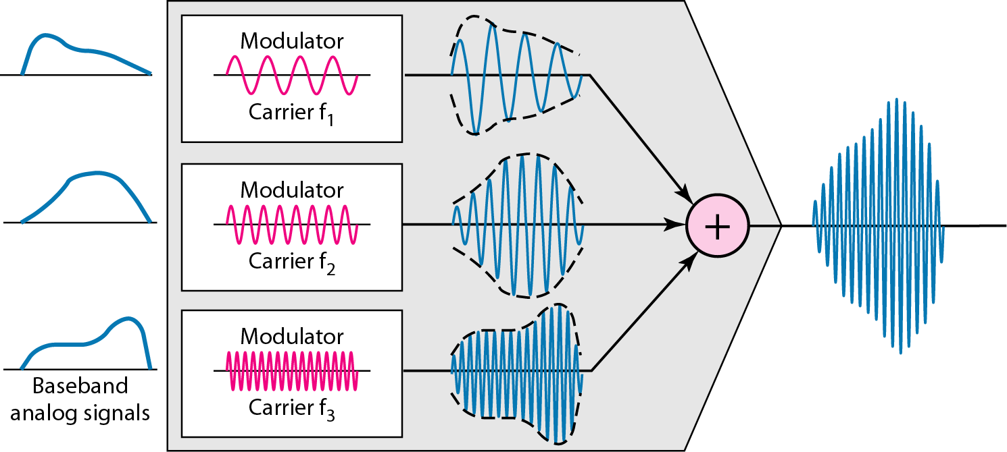
Figure 6.4: FDM Process
6.‹#›
Notes:
6.#

Slide 10
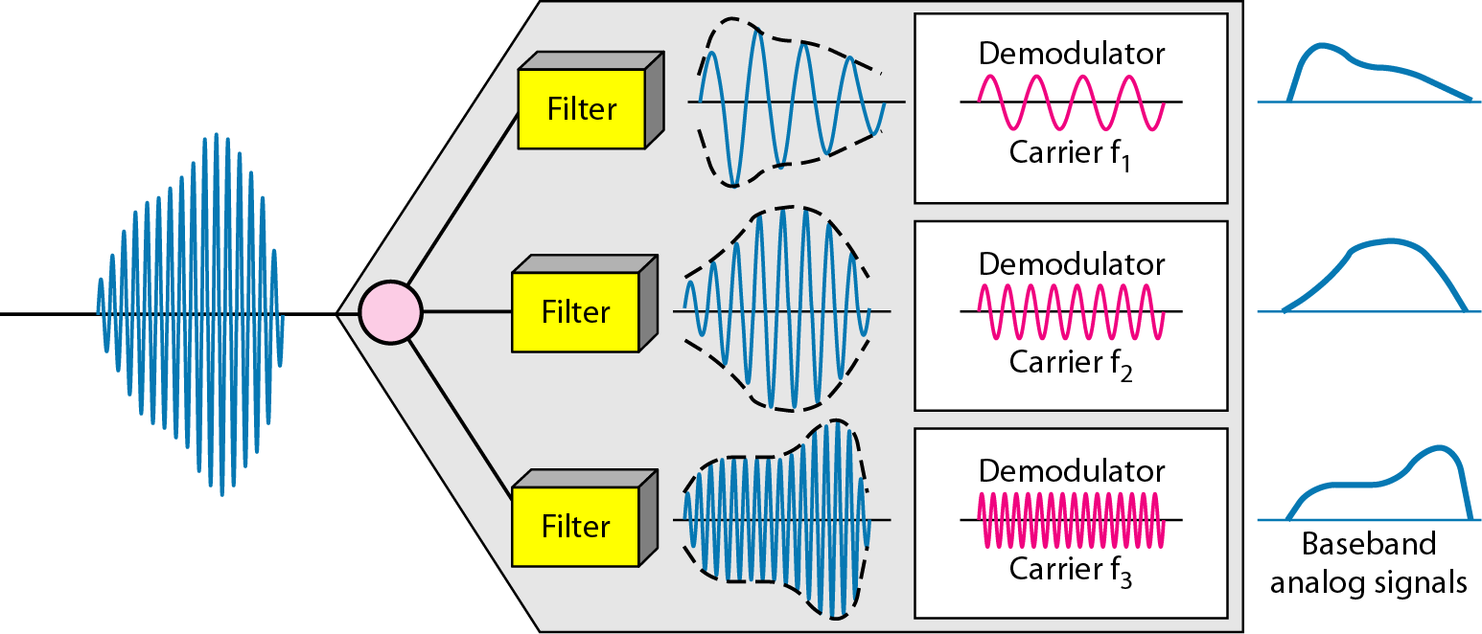
Figure 6.5: FDM demultiplexing example
6.‹#›
Notes:
6.#

Slide 11
Example 6.1
Assume that a voice channel occupies a bandwidth of 4 kHz. We need to combine three voice channels into a link with a bandwidth of 12 kHz, from 20 to 32 kHz. Show the configuration, using the frequency domain. Assume there are no guard bands.
Solution
We shift (modulate) each of the three voice channels to a different bandwidth, as shown in Figure 6.6.
6.‹#›
Notes:
‹#›

Slide 12
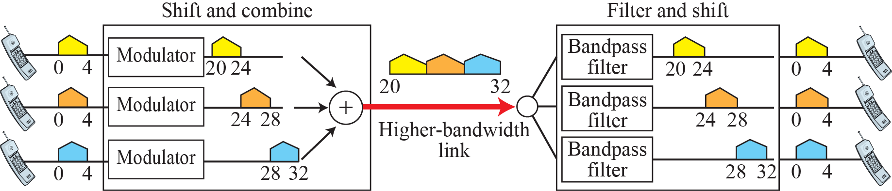
Figure 6.6: Example 6.1
6.‹#›
Notes:
6.#

Slide 13
Example 6.2
Five channels, each with a 100-kHz bandwidth, are to be multiplexed together. What is the minimum bandwidth of the link if there is a need for a guard band of 10 kHz between the channels to prevent interference?
Solution
For five channels, we need at least four guard bands. This means that the required bandwidth is at least 5 × 100 + 4 × 10 = 540 kHz, as shown in Figure 6.7.
6.‹#›
Notes:
‹#›

Slide 14
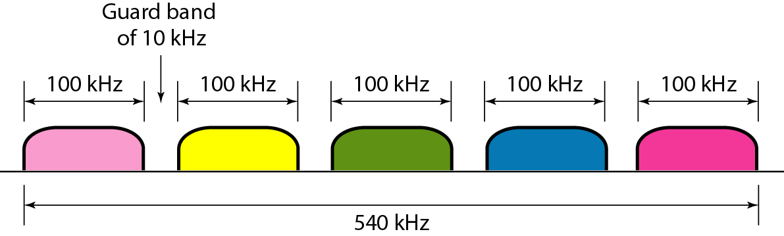
Figure 6.7: Example 6.2
6.‹#›
Notes:
6.#

Slide 15
Example 6.3
Four data channels (digital), each transmitting at 1 Mbps, use a satellite channel of 1 MHz. Design an appropriate configuration, using FDM.
Solution
The satellite channel is analog. We divide it into four channels, each channel having a 250-kHz bandwidth. Each digital channel of 1 Mbps is modulated so that each 4 bits is modulated to 1 Hz. One solution is 16-QAM modulation. Figure 6.8 shows one possible configuration.
6.‹#›
Notes:
‹#›

Slide 16
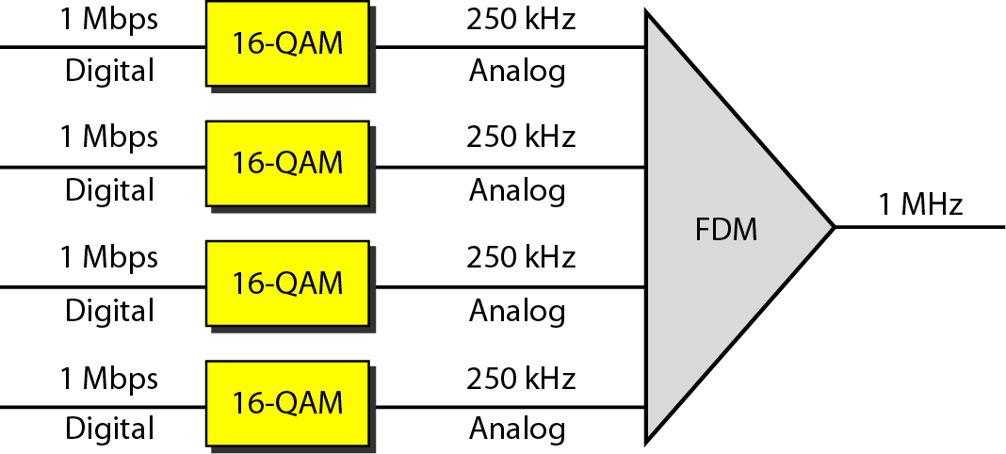
Figure 6.8: Example 6.3
6.‹#›
Notes:
6.#

Slide 17
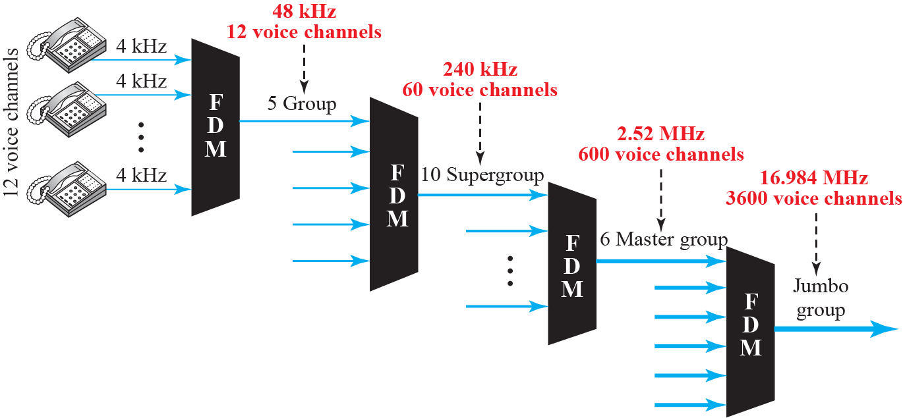
Figure 6.9: Analog hierarchy
6.‹#›
Notes:
6.#

Slide 18
Example 6.4
The Advanced Mobile Phone System (AMPS) uses two bands. The first band of 824 to 849 MHz is used for sending, and 869 to 894 MHz is used for receiving. Each user has a bandwidth of 30 kHz in each direction. The 3-kHz voice is modulated using FM, creating 30 kHz of modulated signal. How many people can use their cellular phones simultaneously?.
Solution
Each band is 25 MHz. If we divide 25 MHz by 30 kHz, we get 833.33. In reality, the band is divided into 832 channels. Of these, 42 channels are used for control, which means only 790 channels are available for cellular phone users.
6.‹#›
Notes:
‹#›

Slide 19
6.6.2 Wavelength-Division Multiplexing
Wavelength-division multiplexing (WDM) is designed to use the high-data-rate capability of fiber-optic cable. The optical fiber data rate is higher than the data rate of metallic transmission cable, but using a fiber-optic cable for a single line wastes the available bandwidth. Multiplexing allows us to combine several lines into one.
6.‹#›
Notes:
6.#

Slide 20
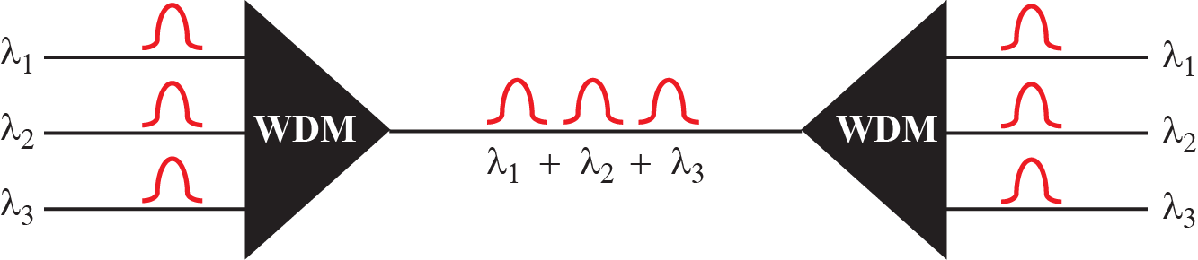
Figure 6.10: Wavelength-division multiplexing
6.‹#›
Notes:
6.#

Slide 21
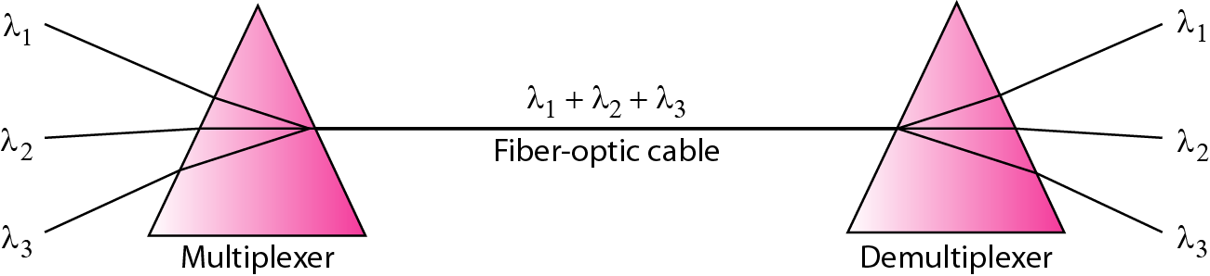
Figure 6.11: Prisms in wave-length division multiplexing
6.‹#›
Notes:
6.#

Slide 22
6.6.3 Time-Division Multiplexing
Time-division multiplexing (TDM) is a digital process that allows several connections to share the high bandwidth of a link. Instead of sharing a portion of the bandwidth as in FDM, time is shared. Each connection occupies a portion of time in the link. Figure 6.12 gives a conceptual view of TDM. Note that the same link is used as in FDM; here, however, the link is shown sectioned by time rather than by frequency. In the figure, portions of signals 1, 2, 3, and 4 occupy the link sequentially.
6.‹#›
Notes:
6.#

Slide 23
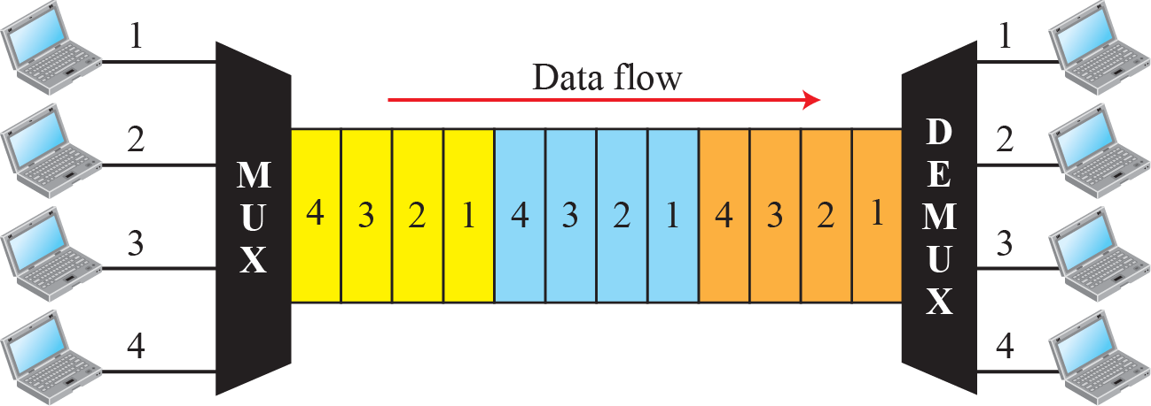
Figure 6.12: TDM
6.‹#›
Notes:
6.#

Slide 24
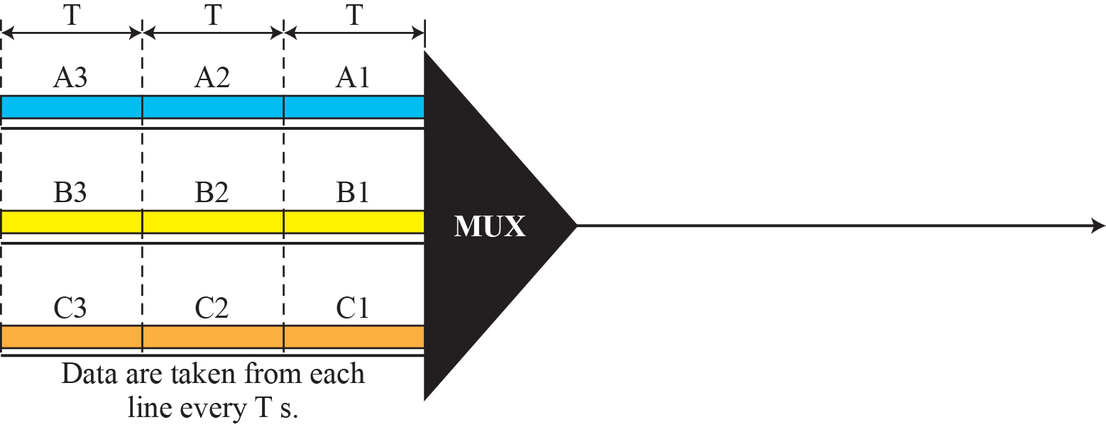
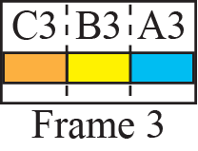
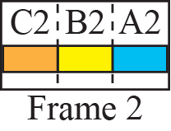
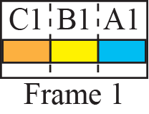
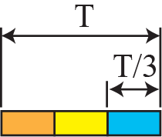
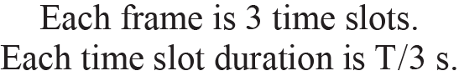
Figure 6.13: Synchronous time-division multiplexing
6.‹#›
Notes:
6.#

Slide 25
Example 6.5
In Figure 6.13, the data rate for each input connection is 1 kbps. If 1 bit at a time is multiplexed (a unit is 1 bit), what is the duration of
1. each input slot,
2. each output slot, and
3. each frame?
6.‹#›
Notes:
‹#›

Slide 26
Example 6.5 (continued)
Solution
We can answer the questions as follows:
1. The data rate of each input connection is 1 kbps. This means that the bit duration is 1/1000 s or 1 ms. The duration of the input time slot is 1 ms (same as bit duration).
2. The duration of each output time slot is one-third of the input time slot. This means that the duration of the output time slot is 1/3 ms.
3. Each frame carries three output time slots. So the duration of a frame is 3 × (1/3) ms, or 1 ms. The duration of a frame is the same as the duration of an input unit.
6.‹#›
Notes:
‹#›

Slide 27
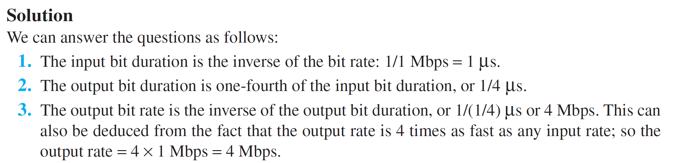
Example 6.6
Figure 6.14 shows synchronous TDM with a data stream for each input and one data stream for the output. The unit of data is 1 bit. Find (a) the input bit duration, (b) the output bit duration, (c) the output bit rate, and (d) the output frame rate.
6.‹#›
Notes:
‹#›

Slide 28
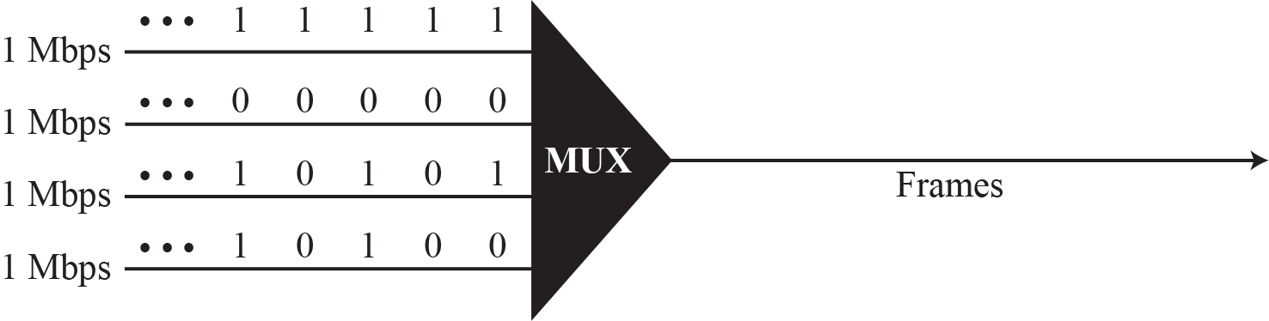
Figure 6.14: Example 6.6
6.‹#›
Notes:
6.#

Slide 29
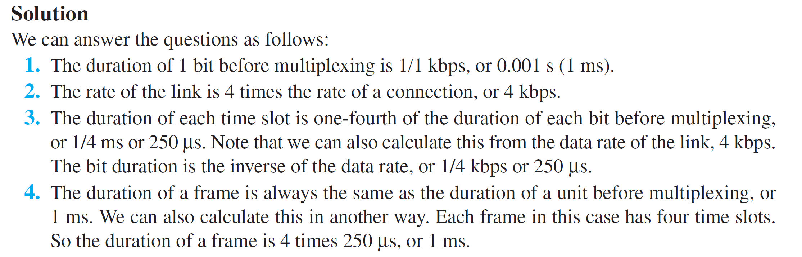
Example 6.7
Four 1-kbps connections are multiplexed together. A unit is 1 bit. Find (1) the duration of 1 bit before multiplexing, (2) the transmission rate of the link, (3) the duration of a time slot, and (4) the duration of a frame.
6.‹#›
Notes:
‹#›

Slide 30
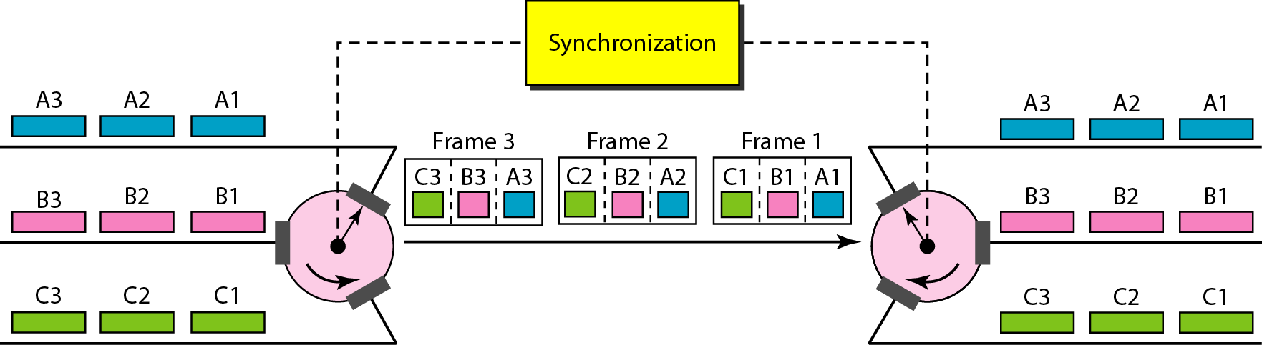
Figure 6.15: Interleaving
6.‹#›
Notes:
6.#

Slide 31
Example 6.8
Four channels are multiplexed using TDM. If each channel sends 100 bytes/s and we multiplex 1 byte per channel, show the frame traveling on the link, the size of the frame, the duration of a frame, the frame rate, and the bit rate for the link.
Solution
The multiplexer is shown in Figure 6.16. Each frame carries 1 byte from each channel; the size of each frame, therefore, is 4 bytes, or 32 bits. The frame rate is 100 frames per second. The duration of a frame is therefore 1/100 s. The link is carrying 100 frames per second, and since each frame contains 32 bits, the bit rate is 100 × 32, or 3200 bps.
6.‹#›
Notes:
‹#›

Slide 32
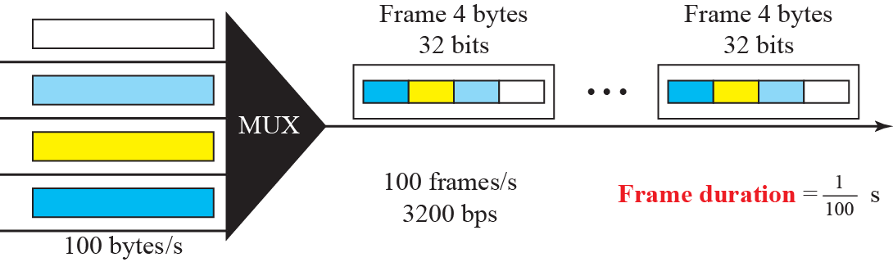
Figure 6.16: Example 6.8
6.‹#›
Notes:
6.#

Slide 33
Example 6.9
A multiplexer combines four 100-kbps channels using a time slot of 2 bits. Show the output with four arbitrary inputs. What is the frame rate? What is the frame duration? What is the bit rate? What is the bit duration?
Solution
Figure 6.17 shows the output for four arbitrary inputs. The link carries 50,000 frames per second since each frame contains 2 bits per channel. The frame duration is therefore 1/50,000 s or 20 μs. The frame rate is 50,000 frames per second, and each frame carries 8 bits; the bit rate is 50,000 ×
8 = 400,000 bits or 400 kbps. The bit duration is 1/400,000 s, or 2.5 μs.
6.‹#›
Notes:
‹#›

Slide 34
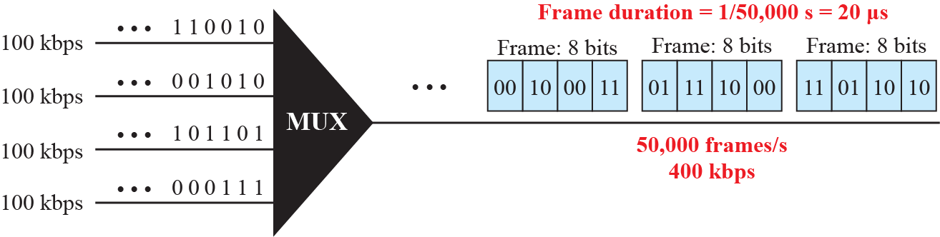
Figure 6.17: Example 6.9
6.‹#›
Notes:
6.#

Slide 35
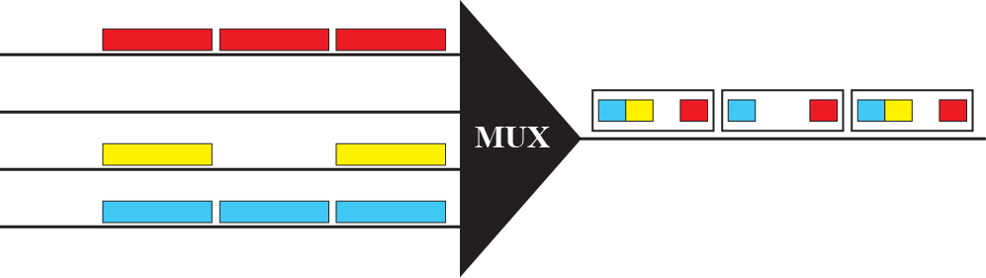
Figure 6.18: Empty slots
6.‹#›
Notes:
6.#

Slide 36
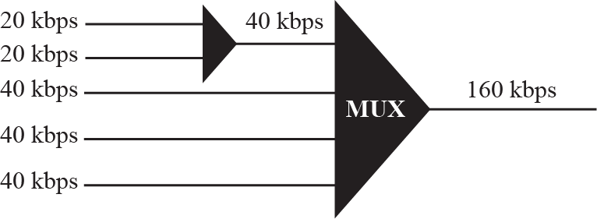
Figure 6.19: Multilevel multiplexing
6.‹#›
Notes:
6.#

Slide 37
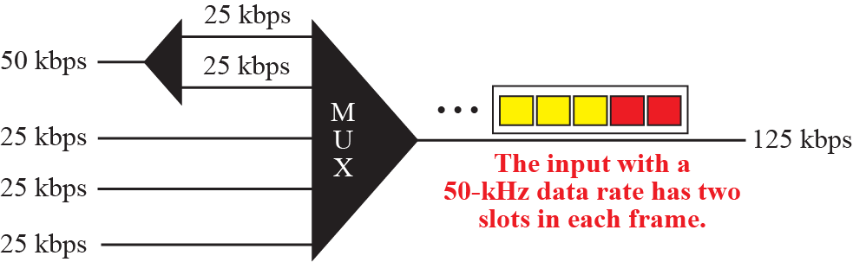
Figure 6.20: Multiple-slot multiplexing
6.‹#›
Notes:
6.#

Slide 38
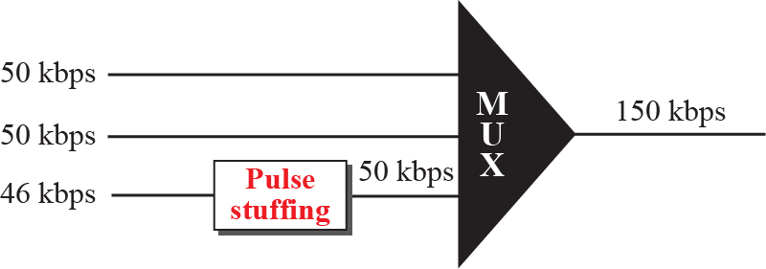
Figure 6.21: Pulse stuffing
6.‹#›
Notes:
6.#

Slide 39
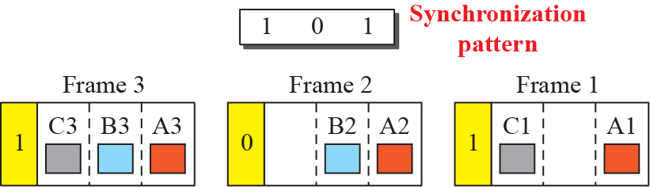
Figure 6.22: Framing bits
6.‹#›
Notes:
6.#

Slide 40
Example 6.10
We have four sources, each creating 250 characters per second. If the interleaved unit is a character and 1 synchronizing bit is added to each frame, find (1) the data rate of each source, (2) the duration of each character in each source, (3) the frame rate, (4) the duration of each frame, (5) the number of bits in each frame, and (6) the data rate of the link.
Solution
1. The data rate of each source is 250 × 8 = 2000 bps = 2 kbps.
2. Each source sends 250 characters per second; therefore, the duration of a character is 1/250 s, or 4 ms.
6.‹#›
Notes:
‹#›

Slide 41
Example 6.10 (Continued)
3. Each frame has one character from each source, which means the link needs to send 250 frames per second.
4. The duration of each frame is 1/250 s, or 4 ms.
5. Each frame carries 4 characters and 1 extra synchronizing bit. This means that each frame is 4 × 8 + 1 = 33 bits.
6. The link sends 250 frames per second, and each frame contains 33 bits. This means that the data rate of the link is 250 × 33, or 8250 bps.
6.‹#›
Notes:
‹#›

Slide 42
Example 6.11
Two channels, one with a bit rate of 100 kbps and another with a bit rate of 200 kbps, are to be multiplexed. How this can be achieved? What is the frame rate? What is the frame duration? What is the bit rate of the link?.
Solution
We can allocate one slot to the first channel and two slots to the second channel. Each frame carries 3 bits. The frame rate is 100,000 frames per second because it carries 1 bit from the first channel. The frame duration is 1/100,000 s, or 10 ms. The bit rate is 100,000 frames/s × 3 bits per
frame, or 300 kbps.
6.‹#›
Notes:
‹#›

Slide 43
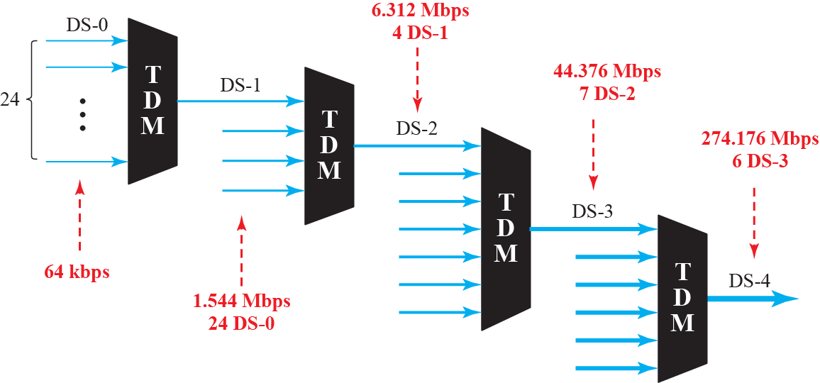
Figure 6.23: Digital hierarchy
6.‹#›
Notes:
6.#

Slide 44
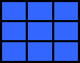
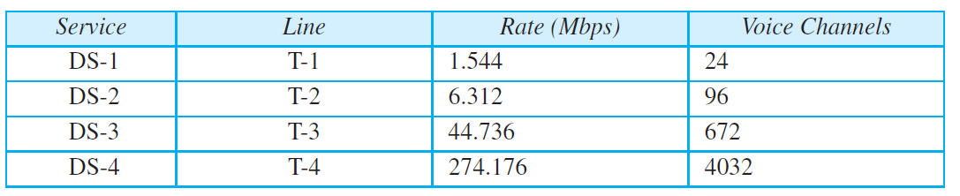
Table 6.1: DS and T line rates
6.‹#›
Notes:
‹#›

Slide 45
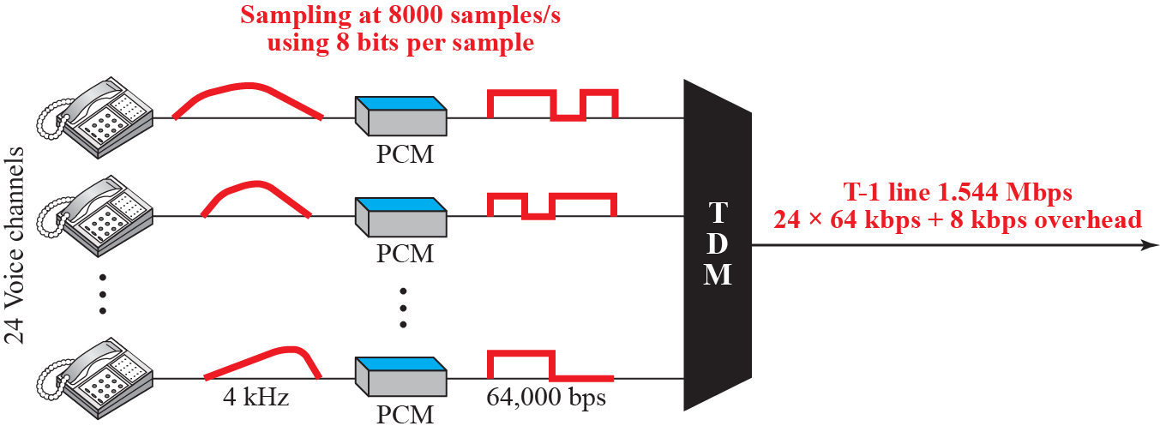
Figure 6.24: T-1 line
6.‹#›
Notes:
6.#

Slide 46
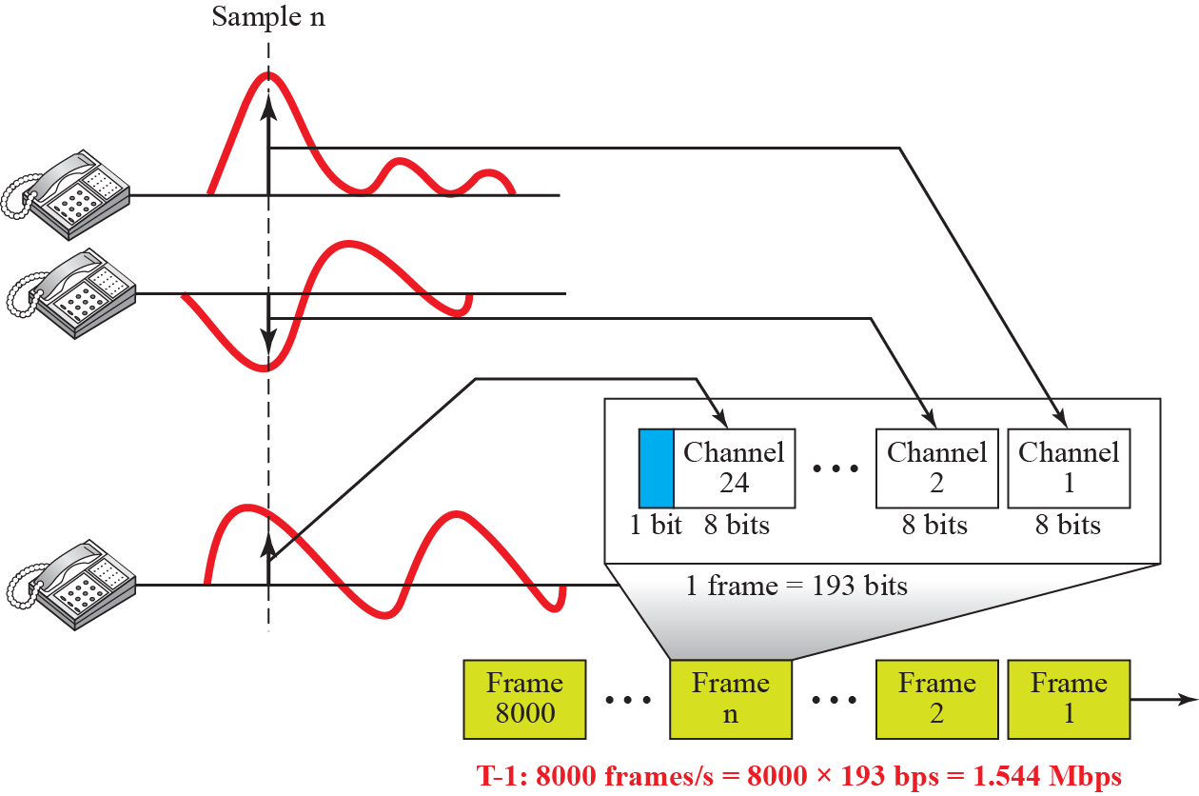
Figure 6.25: T-1 line frame structure
6.‹#›
Notes:
6.#

Slide 47
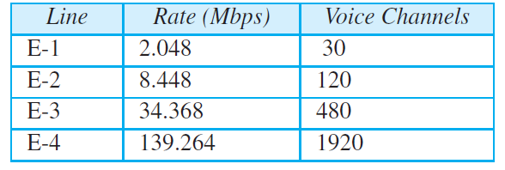
Table 6.2: E line rates
6.‹#›
Notes:
‹#›

Slide 48
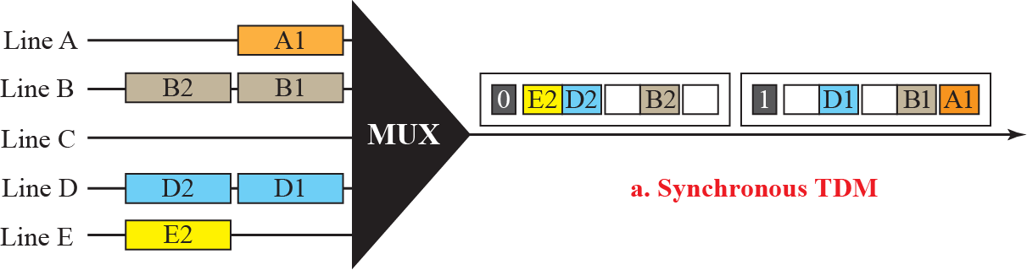
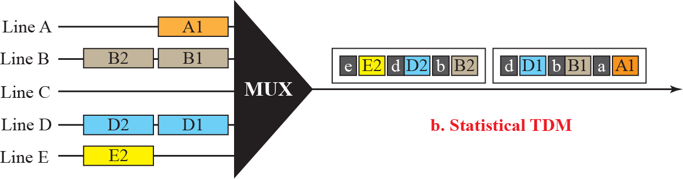
Figure 6.26: TDM slot comparison
6.‹#›
Notes:
6.#

Slide 49
6-2 SPREAD SPECTRUM
In some applications, we have some concerns that outweigh bandwidth efficiency. In wireless applications, stations must be able to share this medium without interception by an eavesdropper and without being subject to jamming from a malicious intruder To achieve these goals, spread spectrum techniques add redundancy;
6.‹#›
Notes:
6.#

Slide 50
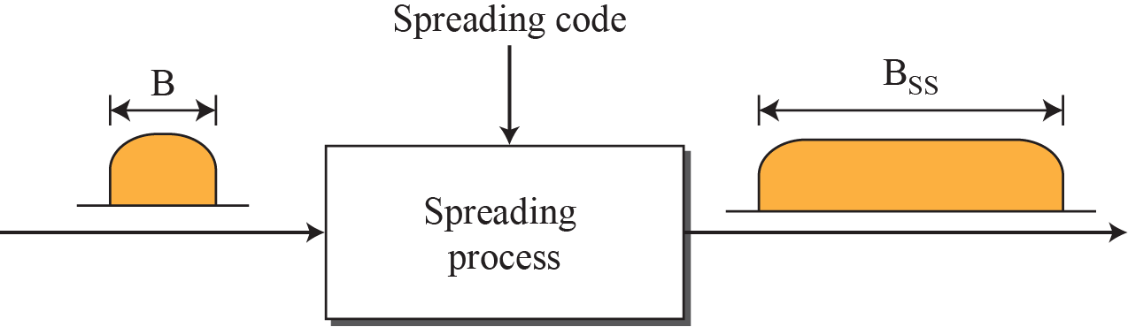
Figure 6.27: Spread spectrum
6.‹#›
Notes:
6.#

Slide 51
6.2.1 FHHS
The Frequency Hopping Spread Spectrum (FHSS) technique uses M different carrier frequencies that are modulated by the source signal. At one moment, the signal modulates one carrier frequency; at the next moment, the signal modulates another carrier frequency. Although the modulation is done using one carrier frequency at a time, M frequencies are used in the long run.
The bandwidth occupied by a source after spreading is B_{FHSS} >> B
6.‹#›
Notes:
6.#

Slide 52
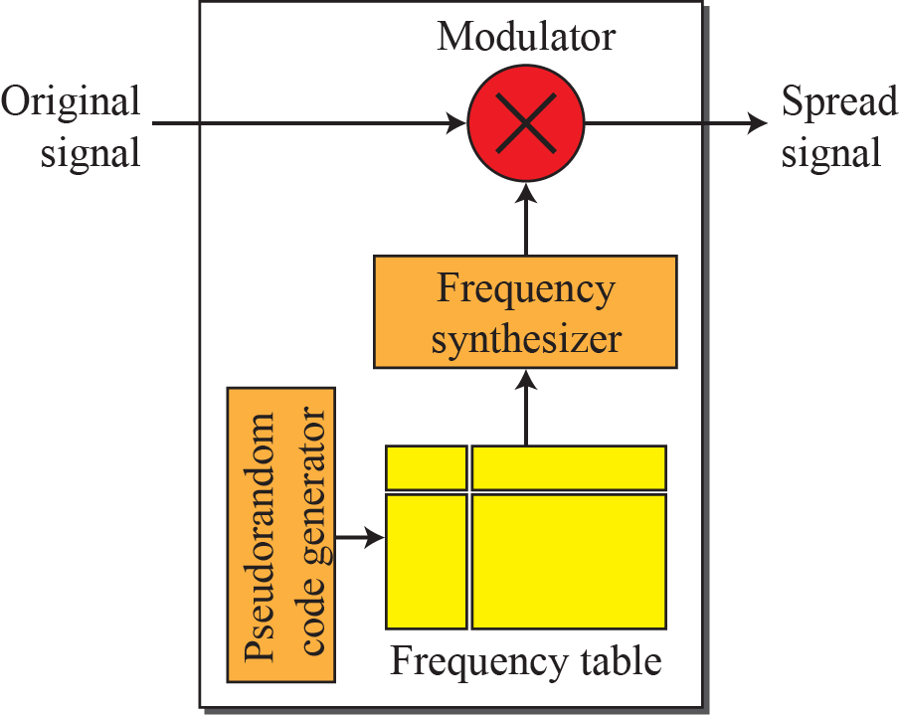
Figure 6.28: Frequency hopping spread spectrum (FHSS)
6.‹#›
Notes:
6.#

Slide 53
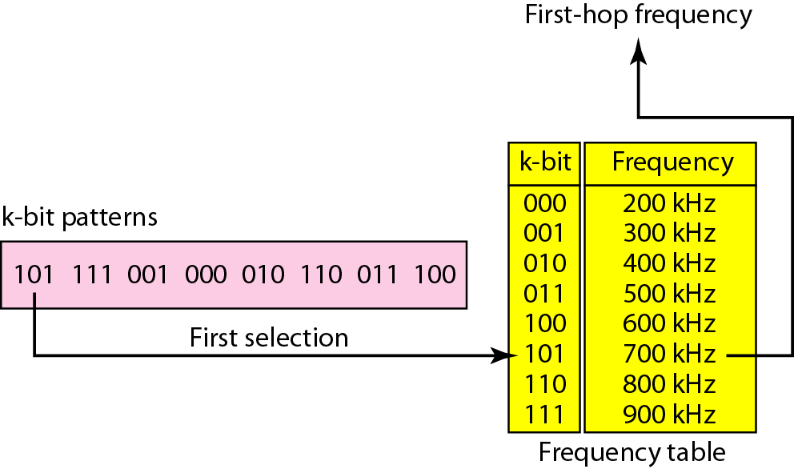
Figure 6.29: Frequency selection in FHSS
6.‹#›
Notes:
6.#

Slide 54
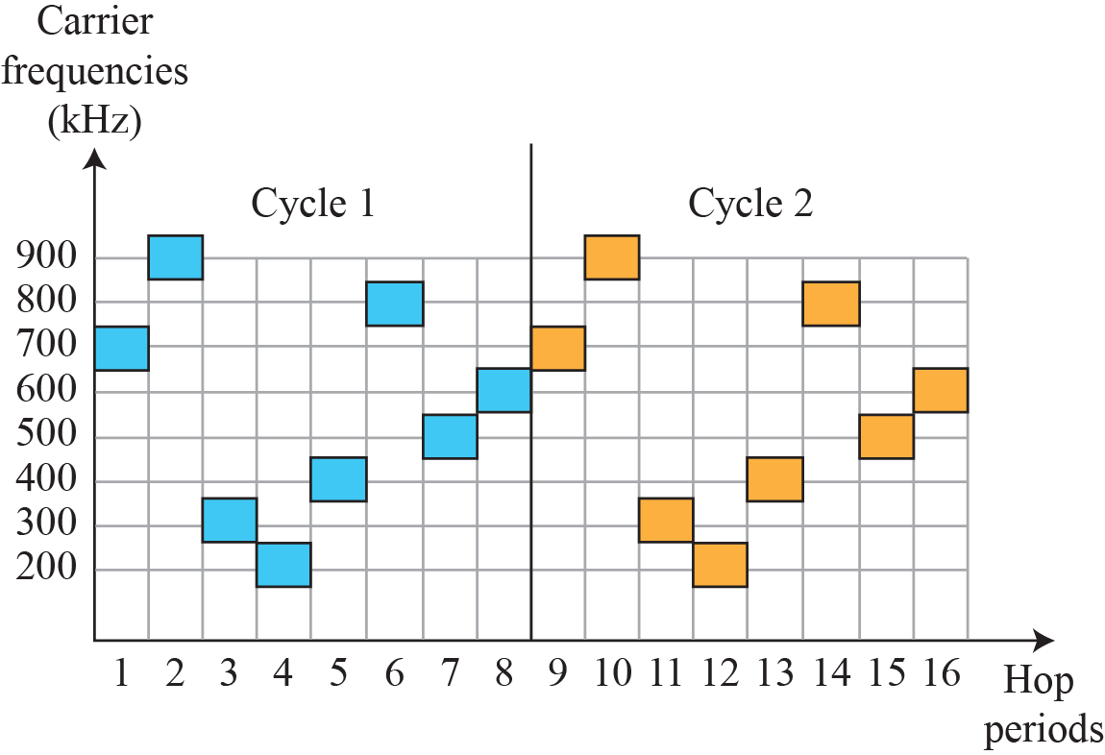
Figure 6.30: FHSS cycles
6.‹#›
Notes:
6.#

Slide 55
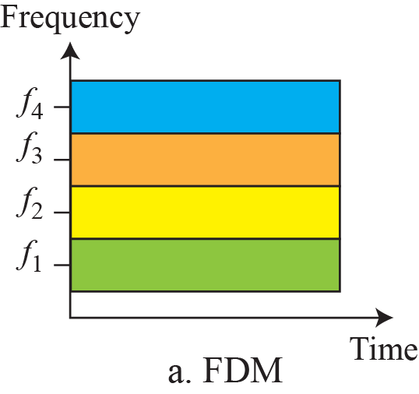
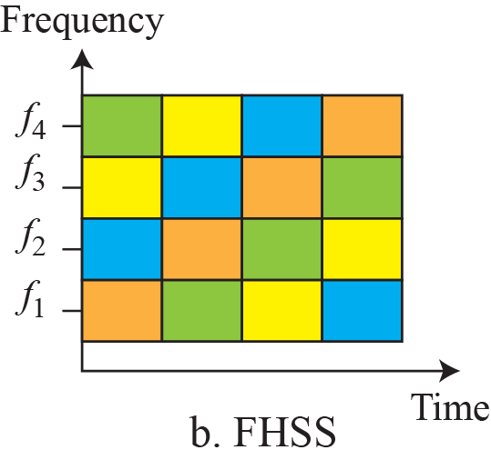
Figure 6.31: Bandwidth sharing
6.‹#›
Notes:
6.#

Slide 56
6.2.2 DSSS
The direct sequence spread spectrum (DSSS) technique also expands the bandwidth of the original signal, but the process is different. In DSSS, we replace each data bit with n bits using a spreading code. In other words, each bit is assigned a code of n bits, called chips, where the chip rate is n times that of the data bit. Figure 6.32 shows the concept of DSSS.
6.‹#›
Notes:
6.#

Slide 57
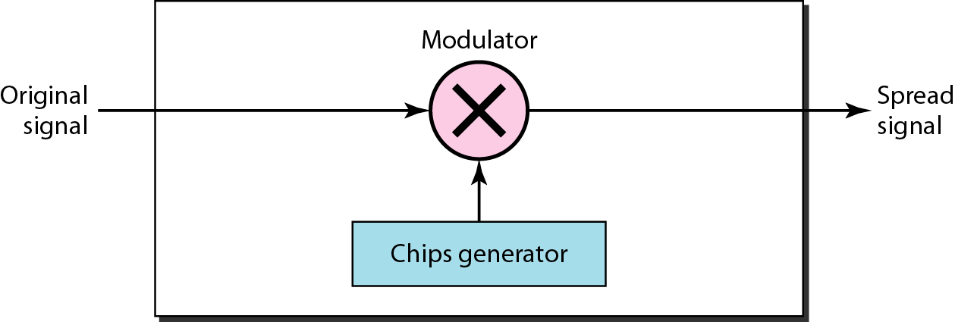
Figure 6.32: DSSS
6.‹#›
Notes:
6.#

Slide 58
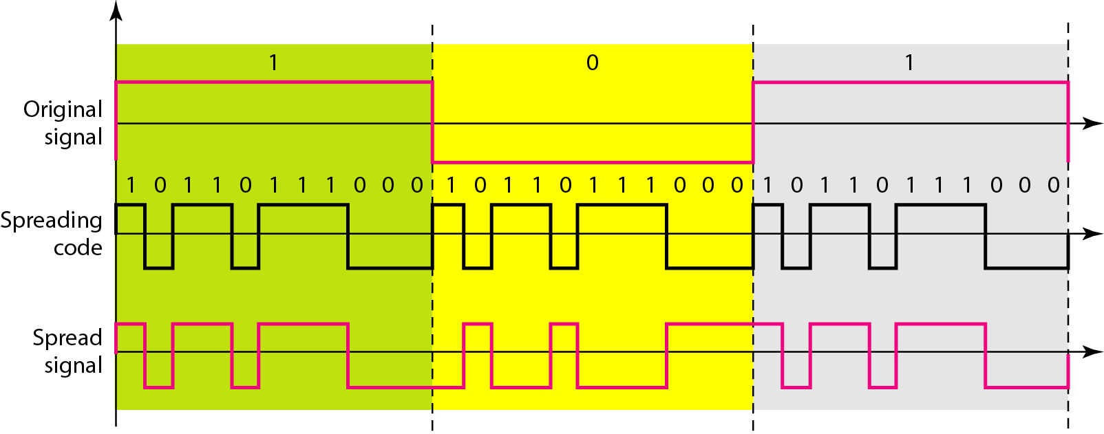
Figure 6.32: DSSS example
6.‹#›
Notes:
6.#

